Slide 1

Deep Learning with Security and Privacy
Jiahui Liu, Luyan Yu

Slide 2
Table of Content
Motivation
Secure Multiparty Computation
Secure MPC of Neural Networks
DeepSecure and Garbled Neural Networks
Yao’s Garbled Circuits
Existing Problems & Project Ideas

Slide 3

Motivation: Private Dating
A trusted bartender
Scenario: Alice and Bob at a pub
If both of them want to date
- they will find out;
If Alice doesn’t want to date
- she won’t learn Bob’s intentions;
If Bob doesn’t want to date
- he won’t learn Alice’s intentions.
Trust Me!

Slide 4

Motivation: Private Auction
Scenario: Many parties in a private auction
The highest bid wins;
Only the highest bid and bidder are revealed.
A trusted auctioneer
Trust Me!

Slide 5
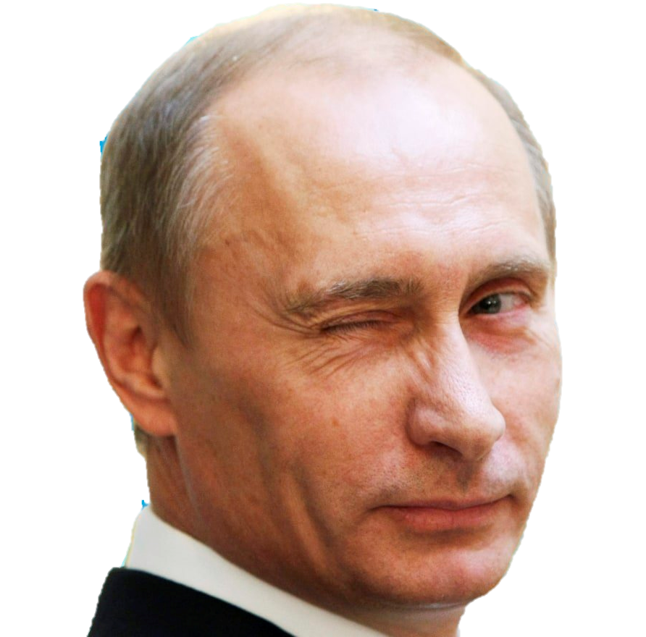
Motivation: Private Set Intersection
Scenario: MI5 and NSA hold lists of terrorists
They would like to compute the intersection;
Any other information must remain secret.
A trusted party
Trust Me!

Slide 6
Motivation
In real world, we DON’T trust anyone.
Trust Me!
Trust Me!
Trust Me!
Goal: Use protocols instead of relying on trusted third parties

Slide 7
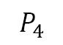
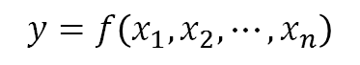
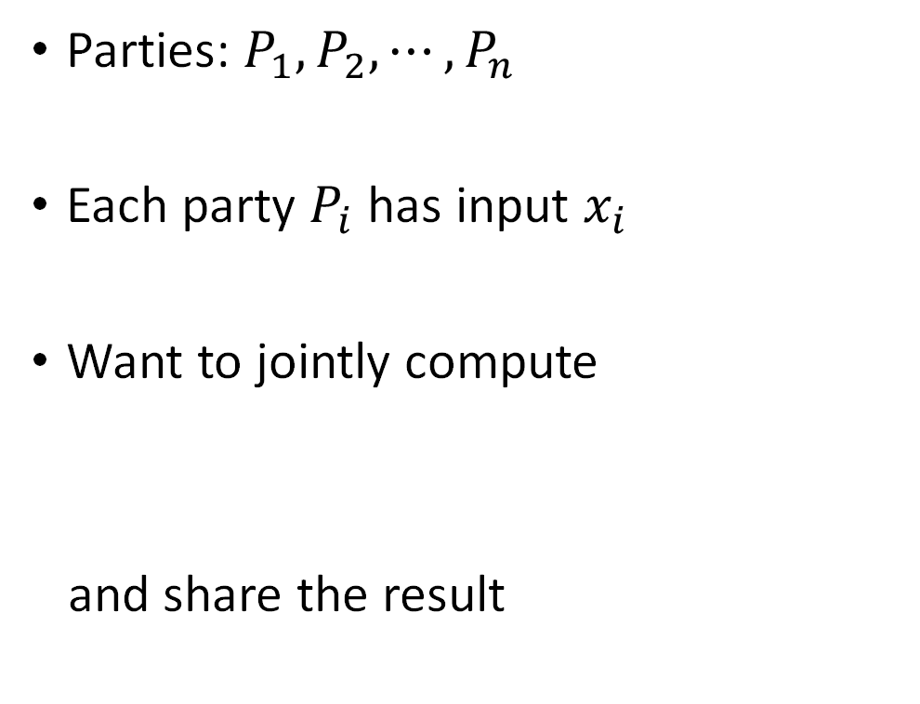
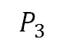
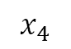
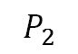
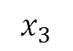
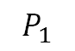
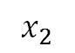
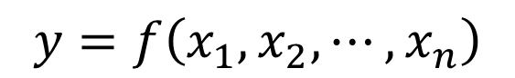
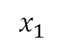
Definition: Multiparty Computation
Parties: $P_{1}, P_{2},⋯,P_{n}$
Each party $P_{i}$ has input $x_{i}$
Want to jointly compute
and share the result
$$P_{1}$$
$$P_{2}$$
$$x_{1}$$
$$x_{2}$$
TP
$$y=f\left(x_{1},x_{2},⋯,x_{n}\right)$$
$$x_{3}$$
$$x_{4}$$
$$y=f\left(x_{1},x_{2},⋯,x_{n}\right)$$
$$P_{3}$$
$$P_{4}$$

Slide 8
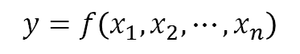
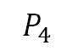
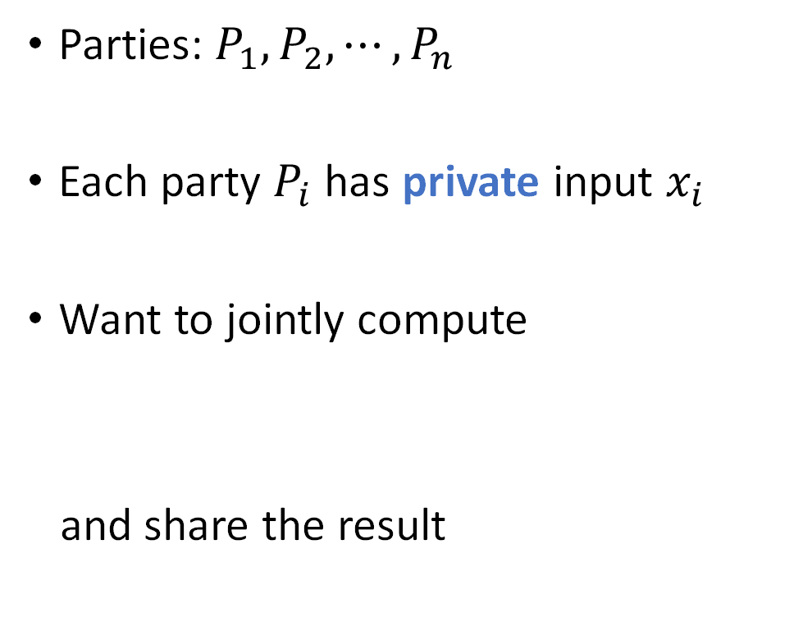
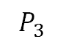
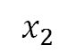
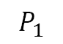
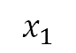
Definition: Secure Multiparty Computation
Parties: $P_{1}, P_{2},⋯,P_{n}$
Each party $P_{i}$ has private input $x_{i}$
Want to jointly compute
and share the result
$$P_{1}$$
$$x_{1}$$
$$x_{2}$$
$$P_{2}$$
$$y=f\left(x_{1},x_{2},⋯,x_{n}\right)$$
$$P_{3}$$
$$x_{3}$$
$$x_{4}$$
$$P_{4}$$
$$y=f\left(x_{1},x_{2},⋯,x_{n}\right)$$
Protocol

Slide 9
Definition: Secure Multiparty Computation
Need a protocol that can preserve:
Correctness
parties obtain correct output;
even some parties misbehave.
Privacy
only the output is learned.
Independence of inputs
parties can’t choose input as a function of other parties’ inputs.
......
$$P_{1}$$
$$x_{1}$$
$$x_{2}$$
$$P_{2}$$
$$y=f\left(x_{1},x_{2},⋯,x_{n}\right)$$
$$P_{3}$$
$$x_{3}$$
$$x_{4}$$
$$P_{4}$$
Protocol

Slide 10

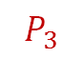
Definition: Secure Multiparty Computation
Should be resistant to adversary
Types of adversary:
Semi-honest: honest-but-curious. follow the protocol honestly but try to learn leaked information.
Malicious: can deviate from the protocol in an arbitrary way.
$$P_{1}$$
$$x_{1}$$
$$x_{2}$$
$$P_{2}$$
$$y=f\left(x_{1},x_{2},⋯,x_{n}\right)$$
$$P_{3}$$
$$x_{3}$$
$$x_{4}$$
$$P_{4}$$
adversary
Protocol

Slide 11
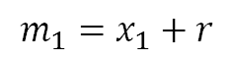
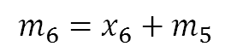
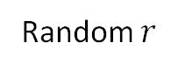
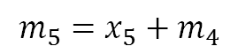
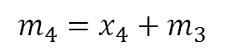
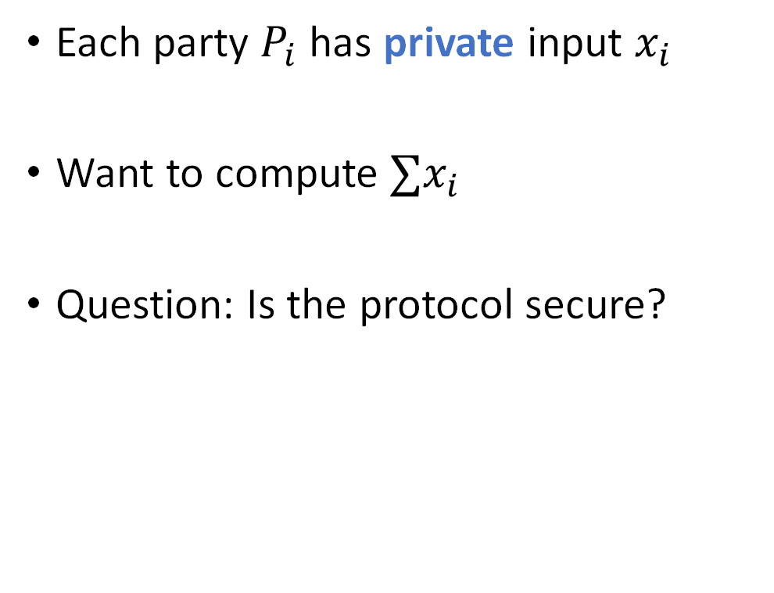
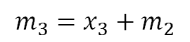
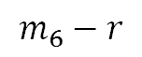
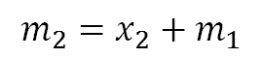
Example: Computing Sum
Random $r$
$$P_{1}$$
𝑃_1
$$P_{2}$$
𝑃_2
$$P_{3}$$
𝑃_3
$$P_{5}$$
𝑃_5
$$P_{6}$$
𝑃_6
$$P_{4}$$
𝑃_4
$$m_{6}=x_{6}+m_{5}$$
$$m_{1}=x_{1}+r$$
Each party $P_{i}$ has private input $x_{i}$
Want to compute $∑x_{i}$
Question: Is the protocol secure?
$$m_{6}−r$$
$$m_{5}=x_{5}+m_{4}$$
$$m_{2}=x_{2}+m_{1}$$
$$m_{4}=x_{4}+m_{3}$$
$$m_{3}=x_{3}+m_{2}$$

Slide 12
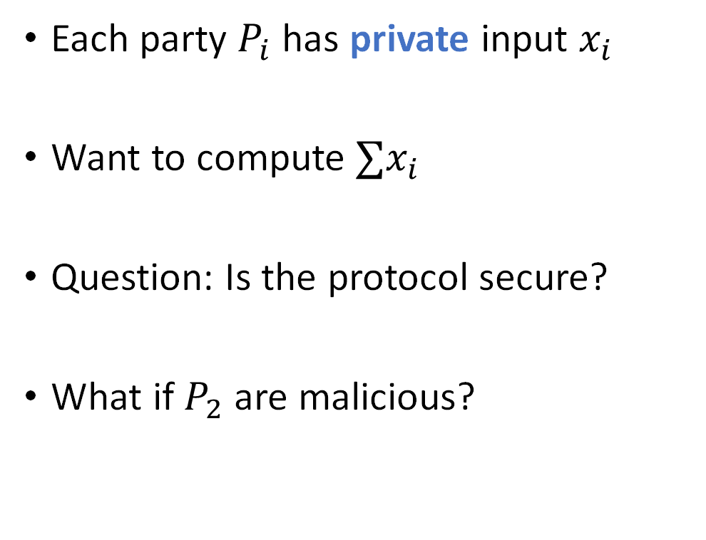
Example: Computing Sum
Random $r$
$$P_{1}$$
𝑃_1
$$P_{2}$$
𝑃_2
$$P_{3}$$
𝑃_3
$$P_{5}$$
𝑃_5
$$P_{6}$$
𝑃_6
$$P_{4}$$
𝑃_4
$$m_{6}=x_{6}+m_{5}$$
$$m_{1}=x_{1}+r$$
Each party $P_{i}$ has private input $x_{i}$
Want to compute $∑x_{i}$
Question: Is the protocol secure?
What if $P_{2}$ are malicious?
$$m_{6}−r$$
$$m_{5}=x_{5}+m_{4}$$
$$m_{2}=x_{2}+m_{1}$$
$$m_{4}=x_{4}+m_{3}$$
$$m_{3}=x_{3}+m_{2}$$

Slide 13


Example: Computing Sum
Random $r$
$$P_{1}$$
𝑃_1
$$P_{2}$$
𝑃_2
$$P_{3}$$
𝑃_3
$$P_{5}$$
𝑃_5
$$P_{6}$$
𝑃_6
$$P_{4}$$
𝑃_4
$$m_{6}=x_{6}+m_{5}$$
$$m_{1}=x_{1}+r$$
Each party $P_{i}$ has private input $x_{i}$
Want to compute $∑x_{i}$
Question: Is the protocol secure?
What if $P_{2}$ and $P_{4}$ are malicious?
$$m_{6}−r$$
$$m_{5}=x_{5}+m_{4}$$
$$m_{2}=x_{2}+m_{1}$$
$$m_{4}=x_{4}+m_{3}$$
$$m_{3}=x_{3}+m_{2}$$

Slide 14

Secure MPC of Neural Network
Focus on this
Training
Evaluation

Slide 15

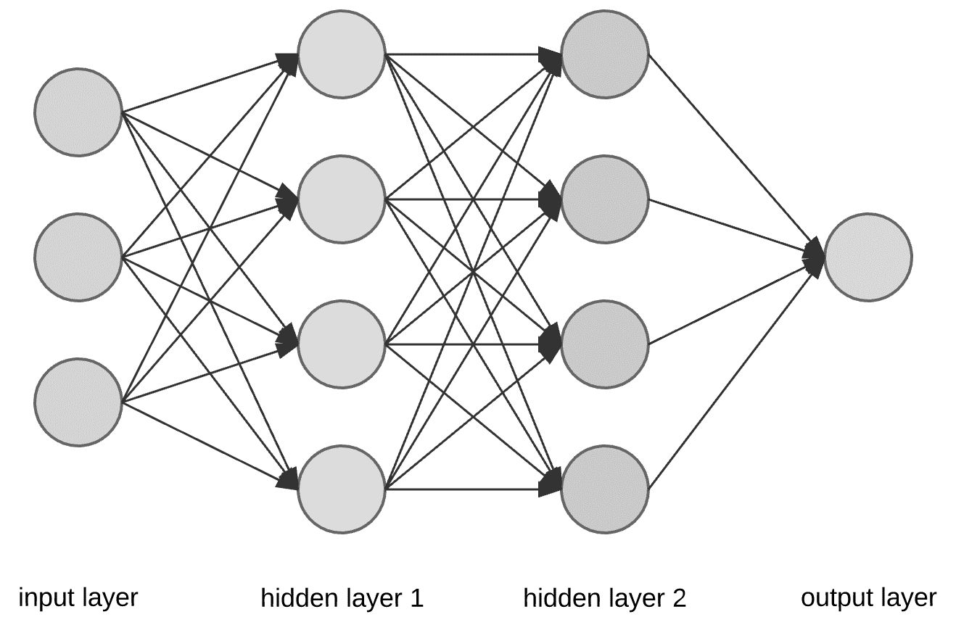

Secure MPC of Neural Network
Scenario: training with private dataset
Google and Facebook both have some private user profile data;
They want to train a public-known neural network without giving away their dataset
$$f\left(x_{g},x_{fb}\right)=GD\left(W,x_{g},x_{fb}\right)$$

Slide 16
Secure MPC of Neural Network
Scenario: training with private dataset
Possible solution: differential privacy.
Idea: create a statistical database from raw dataset that minimizes the information leakage of individual record

Slide 17
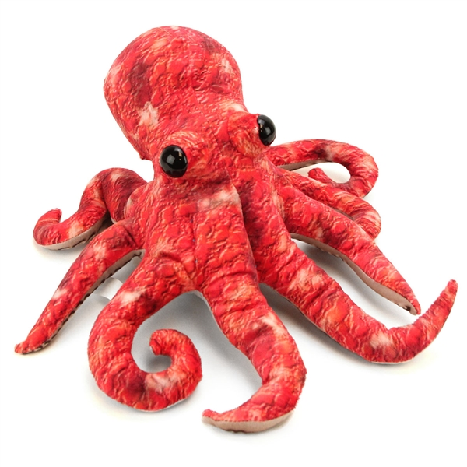


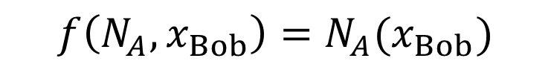
Secure MPC of Neural Network
(our focus)
Scenario: evaluation with private input
Amazon provides already trained neural network for product classification;
Bob, who runs a seafood store, wants to do a classification on his product private images
Octopus
$$f\left(N_{A},x_{Bob}\right)=N_{A}(x_{Bob})$$

Slide 18
Secure MPC of Neural Network
(our focus)
Scenario: evaluation with private input
Differential privacy does not apply – we are interested in the evaluation of a single data point;
Possible solution: Homomorphic Encryption
Octopus

Slide 19
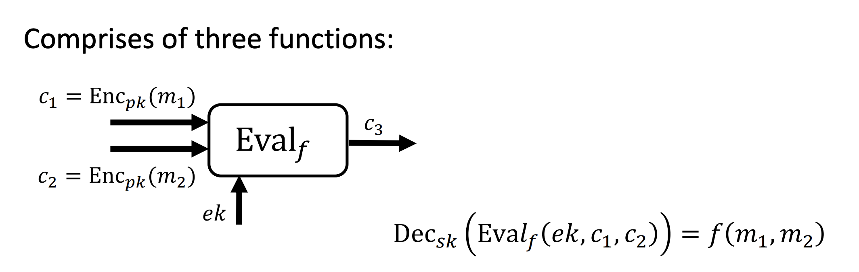
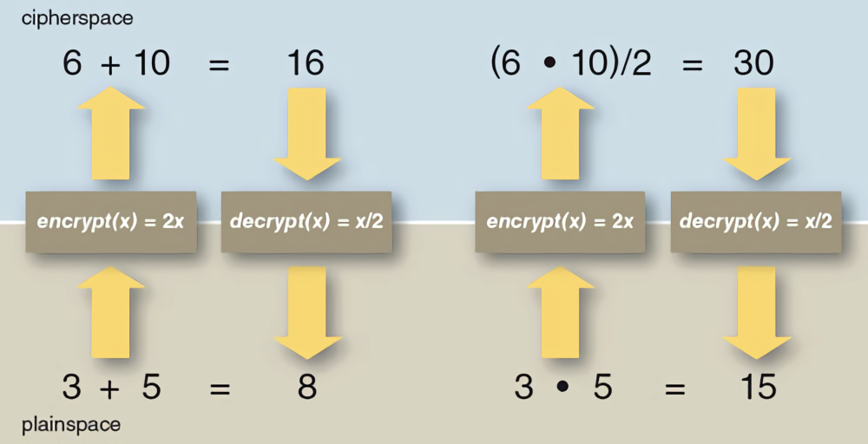
Homomorphic Encryption
Computations happen in the cipherspace

Slide 20
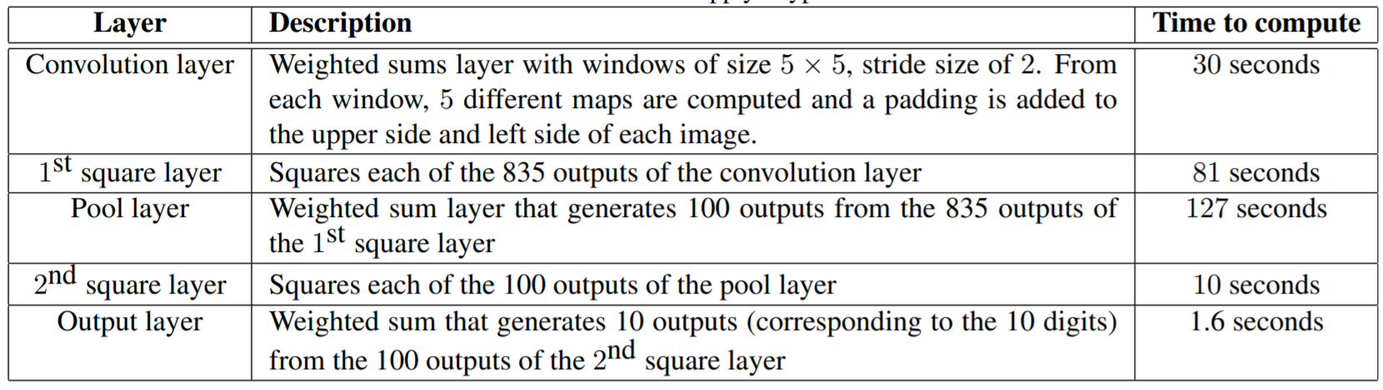
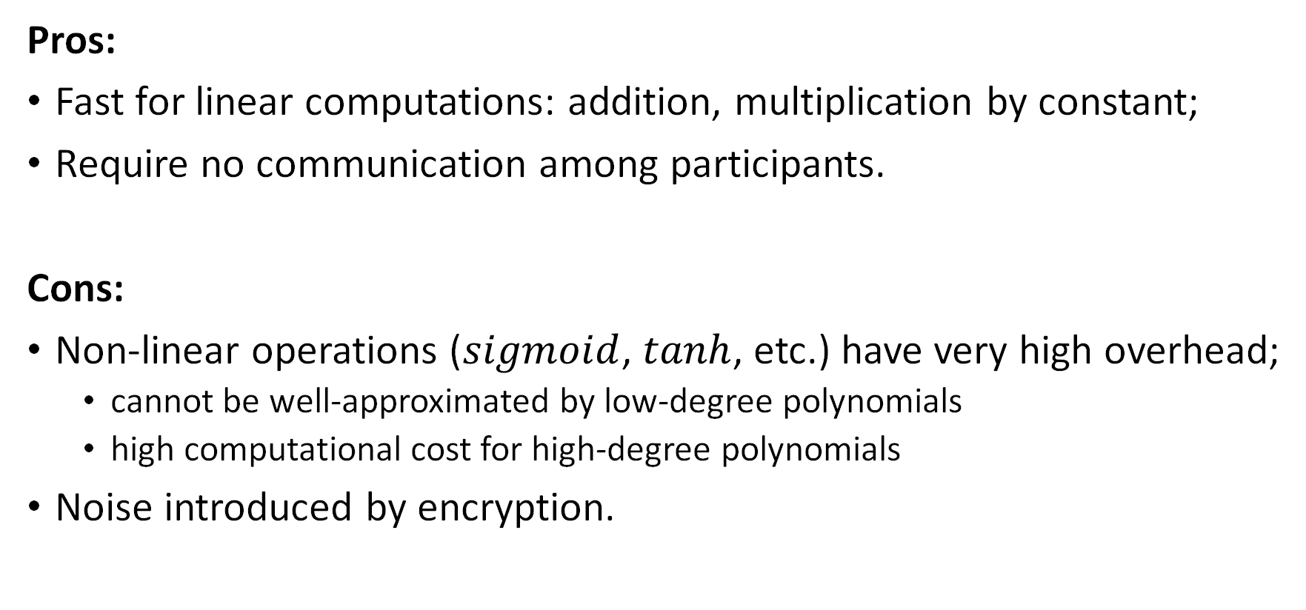
Homomorphic Encryption for DL
Pros:
Fast for linear computations: addition, multiplication by constant;
Require no communication among participants.
Cons:
Non-linear operations ($sigmoid$, $tanh$, etc.) have very high overhead;
cannot be well-approximated by low-degree polynomials
high computational cost for high-degree polynomials
Noise introduced by encryption.
Notes:
Introduce earlier and recall here

Slide 21
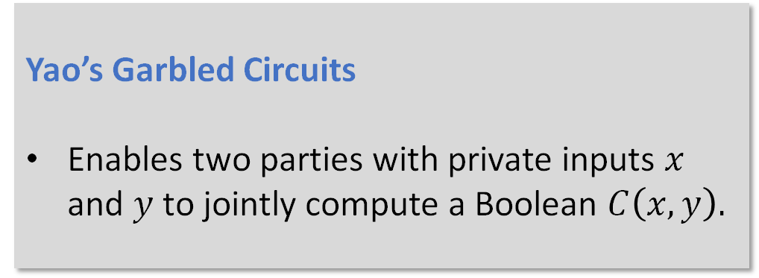
DeepSecure
Yao’s Garbled Circuits
Enables two parties with private inputs $x$ and $y$ to jointly compute a Boolean $C\left(x, y\right).$
Overcome the disadvantage of Homomorphic encryption;
Based on Yao’s Garbled Circuits;
Represent (accurately/approximately) the operations (sum, multiply, non-linear functions, etc.) using Boolean gates.
Rouhani, B. D., et. al. (2018, June). In Proceedings of the 55th Annual Design Automation Conference (p. 2). ACM.

Slide 22
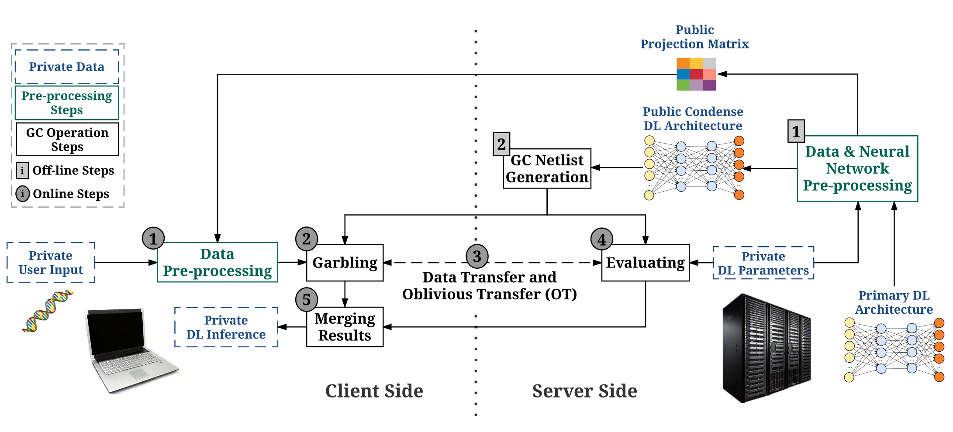
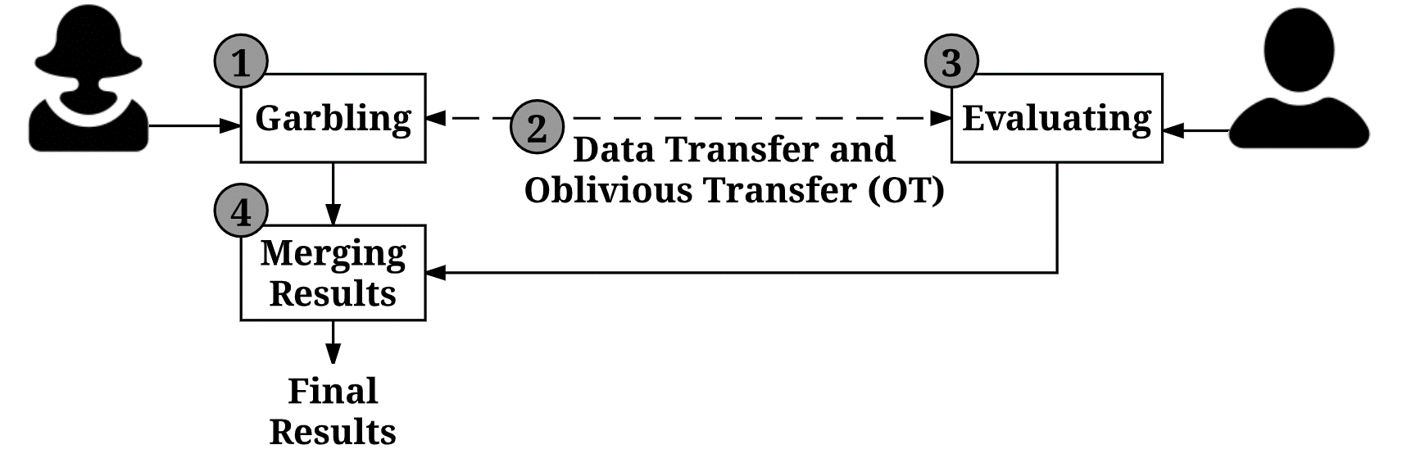
DeepSecure
Rouhani, B. D., et. al. (2018, June). In Proceedings of the 55th Annual Design Automation Conference (p. 2). ACM.

Slide 23
DeepSecure
Core workflow
Rouhani, B. D., et. al. (2018, June). In Proceedings of the 55th Annual Design Automation Conference (p. 2). ACM.

Slide 24
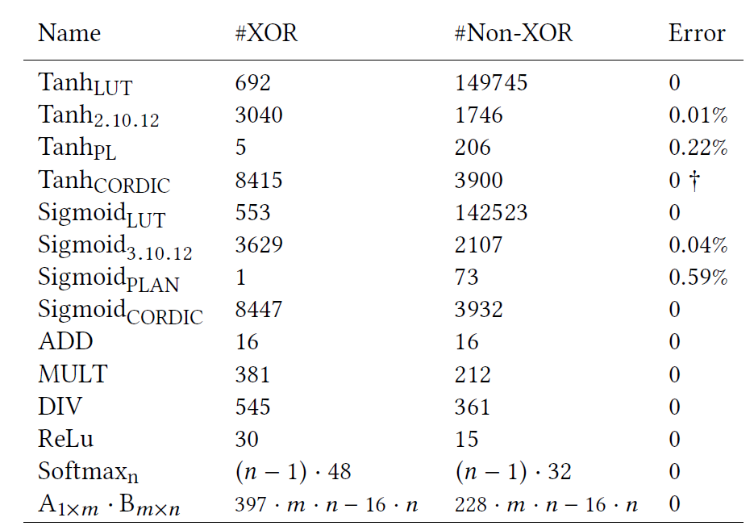
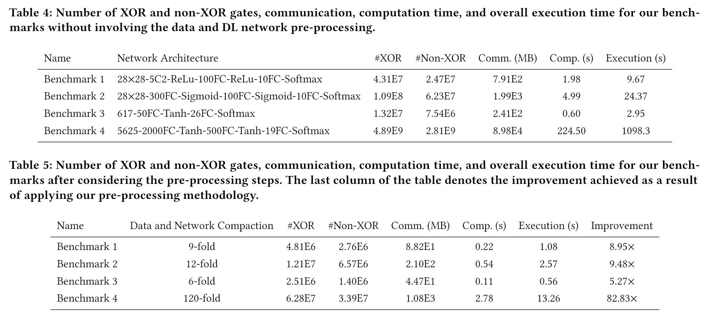
DeepSecure
Still takes a long time
Experiments
Rouhani, B. D., et. al. (2018, June). In Proceedings of the 55th Annual Design Automation Conference (p. 2). ACM.
Notes:
Add accuracy

Slide 25
Garbled Neural Networks [BCMR19]
Fancy-garbling [BCMR19] : Also based on Yao’s Garbled Circuits but uses new techniques on the algorithmic level;
DeepSecure gains efficiency from traditional optimization of garbling(free-XOR, half-gates) and pre-processing;
Fancy-garbling improves the computational time by 40% compared to DeepSecure.
Marshall Ball et al. (2019). Garbled Neural Networks are Practical. IACR Cryptology ePrint Archive 2019

Slide 26
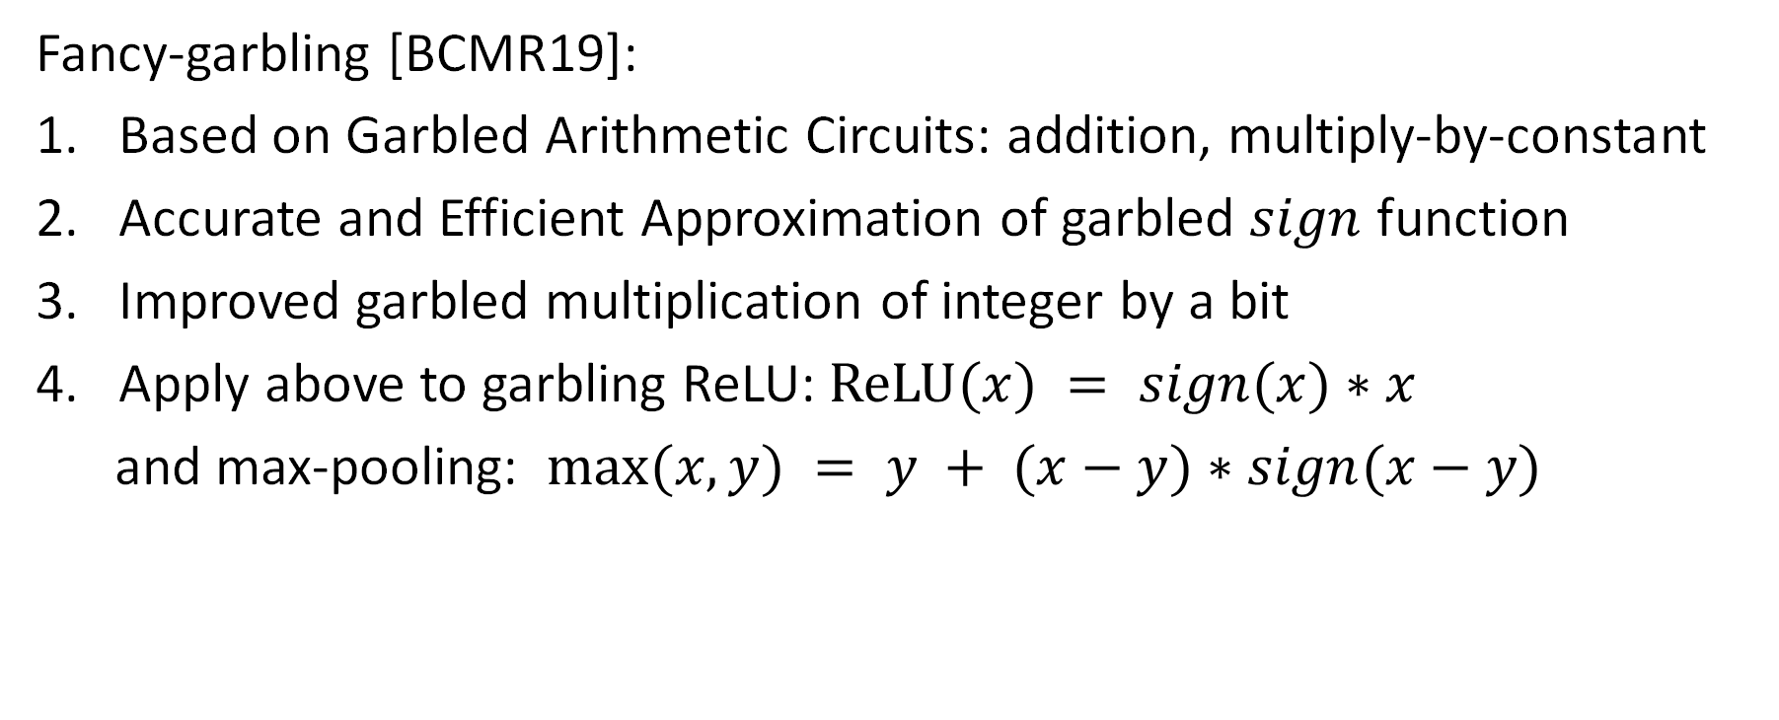
Garbled Neural Networks [BCMR19]
Fancy-garbling [BCMR19]:
Based on Garbled Arithmetic Circuits: addition, multiply-by-constant
Accurate and Efficient Approximation of garbled $sign$ function
Improved garbled multiplication of integer by a bit
Apply above to garbling ReLU: $ReLU(x) = sign(x)∗x$
and max-pooling: $max⁡(x,y) = y + (x−y)∗sign(x−y)$
Marshall Ball et al. (2019). Garbled Neural Networks are Practical. IACR Cryptology ePrint Archive 2019

Slide 27
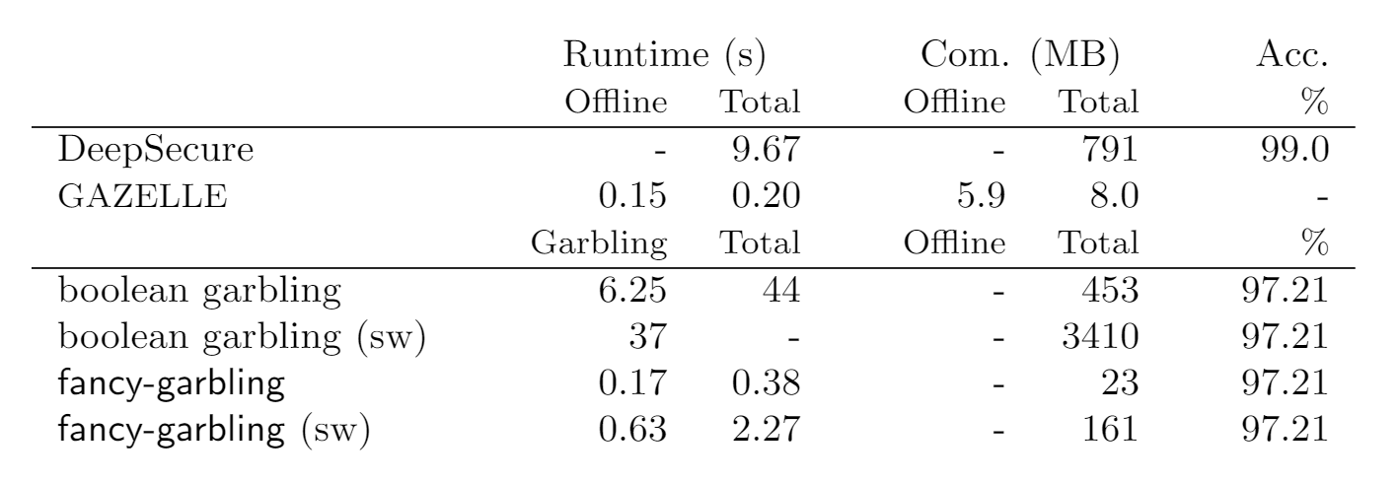
Garbled Neural Networks [BCMR19]
network on MNIST
Marshall Ball et al. (2019). Garbled Neural Networks are Practical. IACR Cryptology ePrint Archive 2019

Slide 28
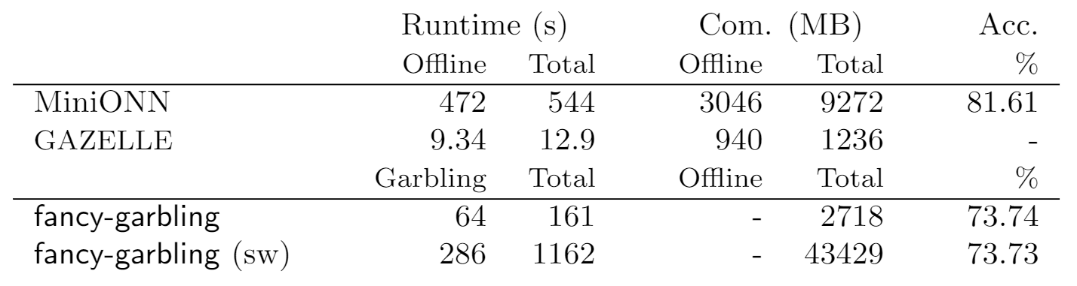
Garbled Neural Networks [BCMR19]
CNN network with $tanh$ activation on CIFAR-10
…due to the replacement of $tanh$ by $sign$
Marshall Ball et al. (2019). Garbled Neural Networks are Practical. IACR Cryptology ePrint Archive 2019

Slide 29

Yao's Garbled Circuits

Slide 30
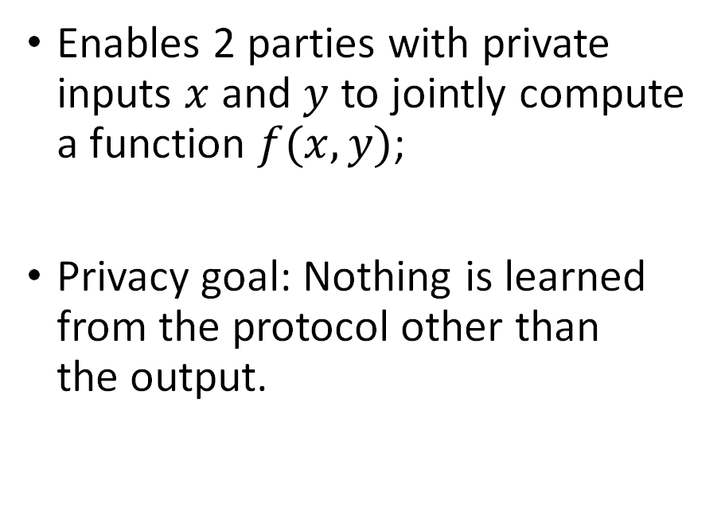
Yao's Garbled Circuits
Enables 2 parties with private inputs $x$ and $y$ to jointly compute a function $f(x, y)$;
Privacy goal: Nothing is learned from the protocol other than the output.
Fun fact:
It’s presented by Turing award winner Andrew Yao in a talk. It cannot be found in any of his papers.

Slide 31
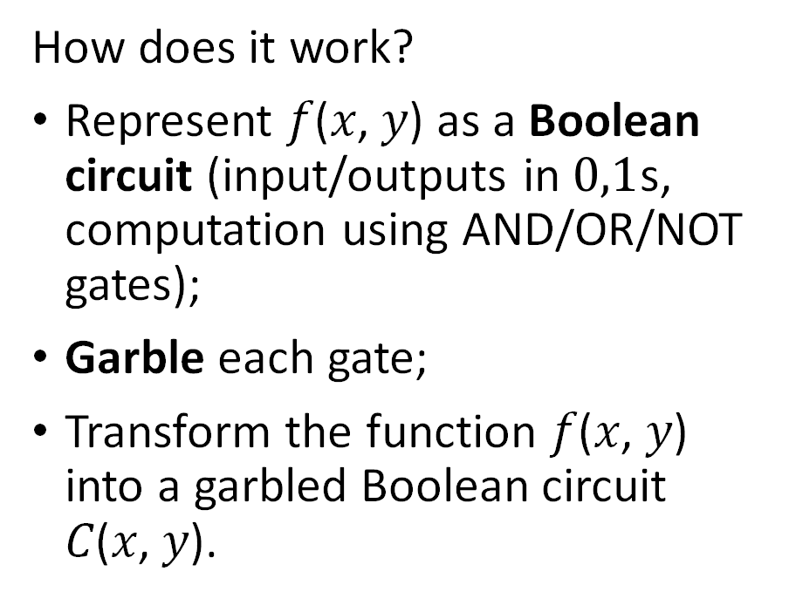
Yao's Garbled Circuits
How does it work?
Represent 𝑓(𝑥, 𝑦) as a Boolean circuit (input/outputs in $0,1$s, computation using AND/OR/NOT gates);
Garble each gate;
Transform the function 𝑓(𝑥, 𝑦) into a garbled Boolean circuit 𝐶(𝑥, 𝑦).
Fun fact:
It’s presented by Turing award winner Andrew Yao in a talk. It cannot be found in any of his papers.

Slide 32
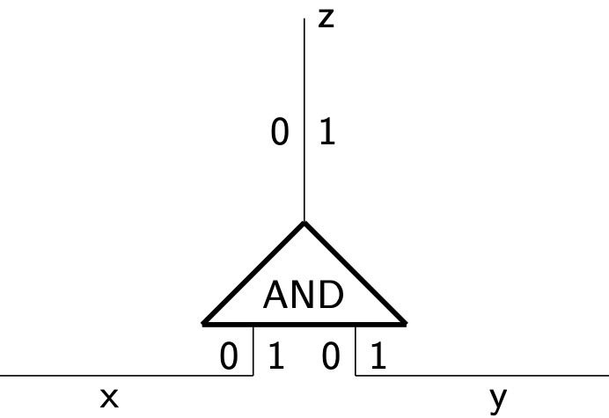
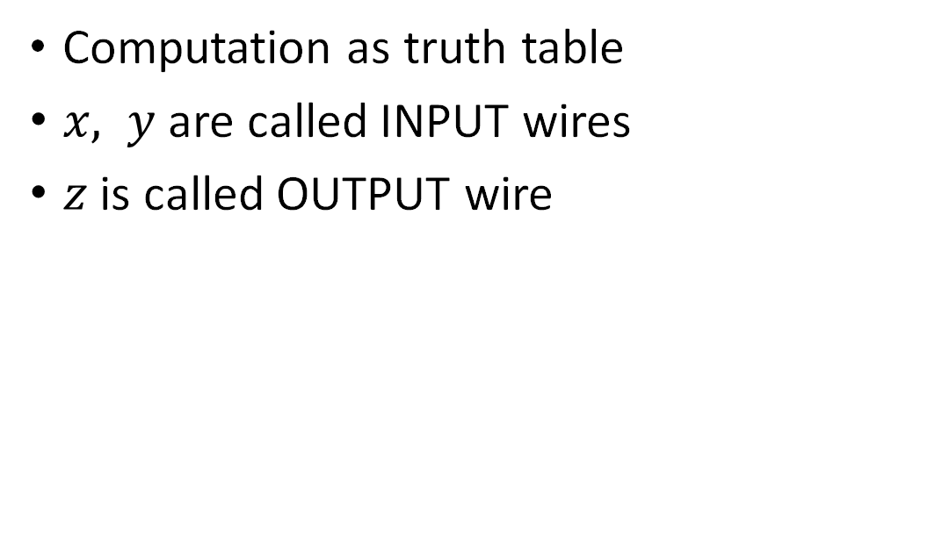
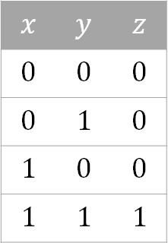
Normal Gate of Boolean Circuits
Computation as truth table
$x, y$ are called INPUT wires
$z$ is called OUTPUT wire
$$x$$ | $$y$$ | $$z$$
$$0$$ | $$0$$ | $$0$$
$$0$$ | $$1$$ | $$0$$
$$1$$ | $$0$$ | $$0$$
$$1$$ | $$1$$ | $$1$$

Slide 33

Normal Gate
Computation as truth table
$x, y$ are called INPUT wires
$z$ is called OUTPUT wire
For each of these three wires we have two values: $0, 1$(input values for the input wires, output values for the output wire).
$$x$$ | $$y$$ | $$z$$
$$0$$ | $$0$$ | $$0$$
$$0$$ | $$1$$ | $$0$$
$$1$$ | $$0$$ | $$0$$
$$1$$ | $$1$$ | $$1$$

Slide 34

Normal Gate
Computation as truth table
$x, y$ are called INPUT wires
$z$ is called OUTPUT wire
For each of these three wires we have two values: $0, 1$(input values for the input wires, output values for the output wire).
Once input values $x, y$ are selected, we can compute $g(x, y)$
$$x$$ | $$y$$ | $$z$$
$$0$$ | $$0$$ | $$0$$
$$0$$ | $$1$$ | $$0$$
$$1$$ | $$0$$ | $$0$$
$$1$$ | $$1$$ | $$1$$
securely?

Slide 35



Yao's Garbled Circuits
Garbler
Evaluator
$$x$$ | $$y$$ | $$z$$
$$0$$ | $$0$$ | $$0$$
$$0$$ | $$1$$ | $$0$$
$$1$$ | $$0$$ | $$0$$
$$1$$ | $$1$$ | $$1$$
Alice and Bob wants to securely compute this AND gate

Slide 36




Construction of Garbled Gate
Garbler
Alice
$$x$$ | $$y$$ | $$z$$
$$0$$ | $$0$$ | $$0$$
$$0$$ | $$1$$ | $$0$$
$$1$$ | $$0$$ | $$0$$
$$1$$ | $$1$$ | $$1$$
replaces the $0,1$ values
$$x$$ | $$y$$ | $$z$$
$$k_{x}^{0}$$ | $$k_{y}^{0}$$ | $$k_{z}^{0}$$
$$k_{x}^{0}$$ | $$k_{y}^{1}$$ | $$k_{z}^{0}$$
$$k_{x}^{1}$$ | $$k_{y}^{0}$$ | $$k_{z}^{0}$$
$$k_{x}^{1}$$ | $$k_{y}^{1}$$ | $$k_{z}^{1}$$

Slide 37


Construction of Garbled Gate
Evaluator
Garbler
Bob
Alice
$$x$$ | $$y$$ | $$z$$
$$k_{x}^{0}$$ | $$k_{y}^{0}$$ | $$k_{z}^{0}$$
$$k_{x}^{0}$$ | $$k_{y}^{1}$$ | $$k_{z}^{0}$$
$$k_{x}^{1}$$ | $$k_{y}^{0}$$ | $$k_{z}^{0}$$
$$k_{x}^{1}$$ | $$k_{y}^{1}$$ | $$k_{z}^{1}$$
encrypts output with inputs
Garbled Table
$$E_{k_{x}^{0},k_{y}^{0}}\left(k_{z}^{0}\right)$$
$$E_{k_{x}^{0},k_{y}^{1}}\left(k_{z}^{0}\right)$$
$$E_{k_{x}^{1},k_{y}^{0}}\left(k_{z}^{0}\right)$$
$$E_{k_{x}^{1},k_{y}^{1}}\left(k_{z}^{1}\right)$$
randomly
permute
With input keys $k_{x}^{a}$ and $k_{y}^{b}$, only $E_{k_{x}^{a},k_{y}^{b}}\left(k_{z}^{AND\left(a,b\right)}\right)$ can be decrypted correctly

Slide 38





Data Transfer
Garbler
Evaluator
Common knowledge
Garbled Table
$$E_{k_{x}^{0},k_{y}^{0}}\left(k_{z}^{0}\right)$$
$$E_{k_{x}^{0},k_{y}^{1}}\left(k_{z}^{0}\right)$$
$$E_{k_{x}^{1},k_{y}^{0}}\left(k_{z}^{0}\right)$$
$$E_{k_{x}^{1},k_{y}^{1}}\left(k_{z}^{1}\right)$$
Alice
Bob
Input $1$
Input $0$
$$x$$ | $$y$$ | $$z$$
$$k_{x}^{0}$$ | $$k_{y}^{0}$$ | $$k_{z}^{0}$$
$$k_{x}^{0}$$ | $$k_{y}^{1}$$ | $$k_{z}^{0}$$
$$k_{x}^{1}$$ | $$k_{y}^{0}$$ | $$k_{z}^{0}$$
$$k_{x}^{1}$$ | $$k_{y}^{1}$$ | $$k_{z}^{1}$$
Bob needs $k_{x}^{1}$ and $k_{y}^{0}$ so he can try to decrypt the garbled table.

Slide 39

Data Transfer
Garbler
Evaluator
Common knowledge
Garbled Table
$$E_{k_{x}^{0},k_{y}^{0}}\left(k_{z}^{0}\right)$$
$$E_{k_{x}^{0},k_{y}^{1}}\left(k_{z}^{0}\right)$$
$$E_{k_{x}^{1},k_{y}^{0}}\left(k_{z}^{0}\right)$$
$$E_{k_{x}^{1},k_{y}^{1}}\left(k_{z}^{1}\right)$$
Alice
Bob
Input $1$
Input $0$
$$x$$ | $$y$$ | $$z$$
$$k_{x}^{0}$$ | $$k_{y}^{0}$$ | $$k_{z}^{0}$$
$$k_{x}^{0}$$ | $$k_{y}^{1}$$ | $$k_{z}^{0}$$
$$k_{x}^{1}$$ | $$k_{y}^{0}$$ | $$k_{z}^{0}$$
$$k_{x}^{1}$$ | $$k_{y}^{1}$$ | $$k_{z}^{1}$$
$$k_{x}^{1}$$
easy

Slide 40






Construction of Garbled Gate
How about the other key?
can decrypt
$$E_{k_{x}^{1},k_{y}^{0}}\left(k_{z}^{0}\right), E_{k_{x}^{1},k_{y}^{1}}\left(k_{z}^{1}\right)$$
Garbler
Evaluator
Garbler
Evaluator
$$0$$
$$k_{y}^{0},k_{y}^{1}$$
Alice
$$k_{y}^{0}$$
Bob
Alice
Bob
Input $1$
Input $0$
Input $1$
Input $0$
naïve method 1
naïve method 2

Slide 41

Oblivious Transfer
Bob receive his key by oblivious transfer protocol, which achieves:
Alice has two entries $e_{0}$, $e_{1}$; Bob has $s∈\left\{0,1\right\}$;
Bob obtains $e_{s}$;
Alice learns nothing about $s$; Bob learns nothing about $e_{1−s}$.

Slide 42

Oblivious Transfer
Garbler
Evaluator
$$k_{y}^{0}$$
Alice
Bob
Input $0$
Based on number theoretic tricks
…like magic

Slide 43

Evaluation
Garbler
Evaluator
Common knowledge
Garbled Table
$$E_{k_{x}^{0},k_{y}^{0}}\left(k_{z}^{0}\right)$$
$$E_{k_{x}^{0},k_{y}^{1}}\left(k_{z}^{0}\right)$$
$$E_{k_{x}^{1},k_{y}^{0}}\left(k_{z}^{0}\right)$$
$$E_{k_{x}^{1},k_{y}^{1}}\left(k_{z}^{1}\right)$$
Alice
Bob
Input $1$
Input $0$
$$x$$ | $$y$$ | $$z$$
$$k_{x}^{0}$$ | $$k_{y}^{0}$$ | $$k_{z}^{0}$$
$$k_{x}^{0}$$ | $$k_{y}^{1}$$ | $$k_{z}^{0}$$
$$k_{x}^{1}$$ | $$k_{y}^{0}$$ | $$k_{z}^{0}$$
$$k_{x}^{1}$$ | $$k_{y}^{1}$$ | $$k_{z}^{1}$$
Bob has $k_{x}^{1}$ and $k_{y}^{0}$

Slide 44


Evaluation
Garbler
Evaluator
Common knowledge
Garbled Table
$$E_{k_{x}^{0},k_{y}^{0}}\left(k_{z}^{0}\right)$$
$$E_{k_{x}^{0},k_{y}^{1}}\left(k_{z}^{0}\right)$$
$$E_{k_{x}^{1},k_{y}^{0}}\left(k_{z}^{0}\right)$$
$$E_{k_{x}^{1},k_{y}^{1}}\left(k_{z}^{1}\right)$$
Alice
Bob
Input $1$
Input $0$
$$x$$ | $$y$$ | $$z$$
$$k_{x}^{0}$$ | $$k_{y}^{0}$$ | $$k_{z}^{0}$$
$$k_{x}^{0}$$ | $$k_{y}^{1}$$ | $$k_{z}^{0}$$
$$k_{x}^{1}$$ | $$k_{y}^{0}$$ | $$k_{z}^{0}$$
$$k_{x}^{1}$$ | $$k_{y}^{1}$$ | $$k_{z}^{1}$$
Bob has $k_{x}^{1}$ and $k_{y}^{0}$
$$k_{z}^{0}$$

Slide 45




Evaluation
Garbler
Evaluator
$$k_{z}^{0}$$
Alice
$$0$$
Bob
Input $1$
Input $0$
They then learn $AND(1,0)=0$,
and they DON’T know each other’s input.

Slide 46

From Gate to Circuit
Represent target function 𝑓(𝑥, 𝑦) as a Boolean circuit

Slide 47








Yao's Garbled Circuits: Protocol Summary
1
2
3
4

Slide 48
Yao's Garbled Circuits: Protocol Summary
Alice constructs a garbled circuit: assign random keys
Alice and Bob use oblivious transfer so that: Bob obtains the key associated with its input on all of its wires; Alice learns nothing about Bob's inputs.
Bob computes the circuit and sends the output back to Alice
Alice sends Bob the garbled computation and her own key

Slide 49
Yao's Garbled Circuits: Pros for use in NN Evaluation
Constant-round protocol
Good for non-linear computations: sign, ReLU; much less computation overhead than HE
Security against semi-honest adversary can be promoted to be secure against malicious adversary

Slide 50
Yao's Garbled Circuits: Cons for use in NN Evaluation
Communication complexity: number of ciphertexts sent proportional to the size of the circuit
Bottleneck: Deep neural networks require more rounds of protocols
Conversion of linear operations to boolean circuits is expensive compared to HE

Slide 51
Yao’s Garbled Circuits: Optimizations
Encryptions at each gate take time: XOR have less costly encryption tricks(Free-XOR); use fewer non-XOR gates.
Reduce the ciphertext size, i.e. number of rows in the garbled computation table
Approximate functions by circuits with fewer gates

Slide 52

Yao’s Garbled Circuits: “Free-XOR” gate
Alice generates a random (n-1)-bit value R just known to her
For each input/output wire :
generate the key $k_{y}^{0}$
Compute the other key as $k_{y}^{1}=k_{y}^{0}⨁$(R||1)
Output be computed as $k_{z}^{}$= $k_{x}^{}$ $⨁k_{y}^{}$
Reduce half of encryption costs and ciphertexts size

Slide 53

Project ideas
In [BCMR19], networks with $tanh$ is trained with $tanh$ but during evaluation, $sign$ is used. This is possibly the cause of the low accuracy.
Goal: find garbled (approximated) version of $tanh$ to replace the $sign$ function and improve the evaluation accuracy.

Slide 54

Project ideas
We could combine the new garbling method with the "old" ways of homomorphic encryption-based security to potentially improve the performance.

Slide 55
Project ideas
Boost from 2-party secure classification in [BCMR19] to multi-party using the secret-sharing technique:
a third-party with restricted computational power can send one share of their input to Alice, and the other share to Bob;
Both shares are masked with randomness;
Let Alice and Bob do the computation for them.

Slide 56
References
Ran Cohen, Secure Multiparty Computation: Introduction
Konstantinos Gkikas, Yao's Garbled Circuit
David Wu, Computing on Encrypted Data
Riazi et al. Deep Learning on Private Data

Slide 57


Thank You! Q & A
Secure MPC leads to happy collaboration.

Slide 58

Yao's Garbled Circuits: Garbled Gate

Slide 59
Organization
Motivation: secure MPC; differential privacy
Intro: MPC : definition
High level ideas in DeepSecure and Garbled NN
Comparison of performances in past works
Brief overview on NN with differential privacy
Motivation: NN secure MPC; NN with differential privacy
NN with MPC Methods: secret sharing; homomorphic encryption; garbled circuits.

Slide 60
Secure MPC of Neural Network
Secure training of neural networks
Differential privacy
Secure evaluation of already-trained neural networks
Homomorphic Encryption
Garbled Circuits: Garbled Neural Networks
Secret-Sharing
Hybrid protocols of the above

Slide 61
Homomorphic Encryption
Now we go beyond 2-party computation
Secure Function Evaluation can be extended to more than 2-party [GWV87]
But is there a method that requires less communication among the participants?

Slide 62

Yao's Garbled Circuits: Final Evaluation
Bob now has $k_{x}^{b}$ , $k_{y}^{b^{′}}$ and the GCT;
he can compute the gate by decrypting GCT;
Bob can decrypt only one line of GCT, exactly because of its construction;
Bob sends Alice output $k_{z}^{g\left(b,b^{′}\right)}$.

Slide 63

Construction of Garbled Gate
For each wire 𝑥, 𝑦, 𝑧, specify two random values $k^{0}$, $k^{1}$ corresponding to $0$ and $1$.

Slide 64

Yao's Garbled Circuits: Construction of Garbled Gate
View $k_{z}^{0}$, $k_{z}^{1}$, $k_{x}^{0}$, $k_{x}^{1}$, $k_{y}^{0}$, $k_{y}^{1}$ as encryption keys;
Encrypt $k_{z}^{0}$, $k_{z}^{1}$under appropriate pairs of input keys.
Need to “associate” $k_{z}^{0}$, $k_{z}^{1}$, with $k_{x}^{0}$, $k_{x}^{1}$, $k_{y}^{0}$, $k_{y}^{1}$;
We will do that by the garbled truth table.

Slide 65
Yao's Garbled Circuits: Construction of Garbled Gate
Alice prepares GCT;
Alice picks two random keys for each wire thus she has 6 keys in total;
Alice encrypts each row of the table, creating the GCT;
Alice randomly permutes it;
Now the key’s position reveals nothing about the value it associated with.

Slide 66

Yao's Garbled Circuits: Construction of Garbled Gate
Alice publishes GCT;
Alice sends Bob her input key $k_{x}^{b}$ ($b$ is her input value);
Bob also needs his own key to decrypt the GCT;
Alice must send the key $k_{y}^{b^{′}}$to him.

Slide 67

Yao's Garbled Circuits: Oblivious Transfer
Dilemma:
If Alice sends both $k_{y}^{0}$, $k_{y}^{1}$ to Bob
- Bob can decrypt more;
If Bob asks for Alice the key that corresponds to his input
- Alice learns Bob’s input.
How to solve this problem?

Slide 68

Homomorphic Encryption for DL

